Slide 1
Introduction of “GEOTEX TAIWAN”
The best website for offering all of the related medical products for Covid-19.

Slide 2
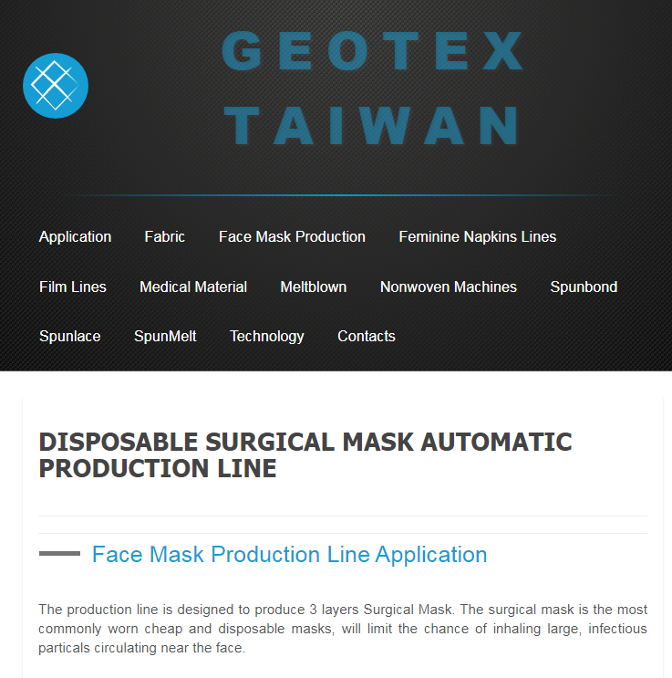
New direction, New project
High Google rankings on the first page
All the solutions for end-to-end service
Professional manufacturers in the medical industry
https://www.geotex.tw/

Slide 3
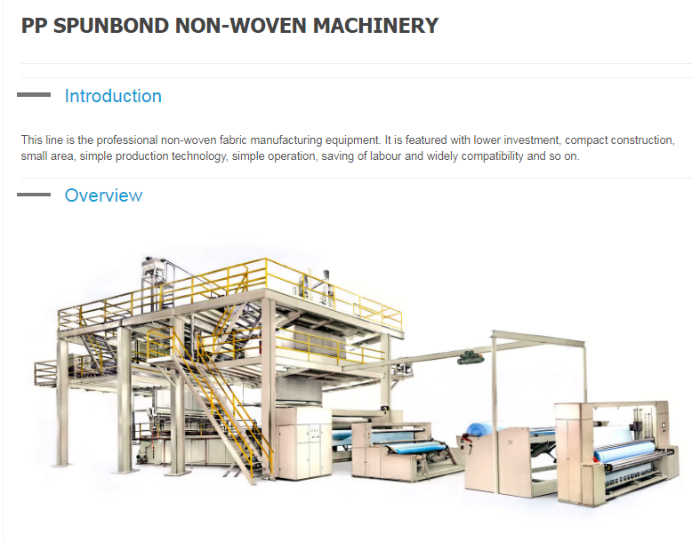
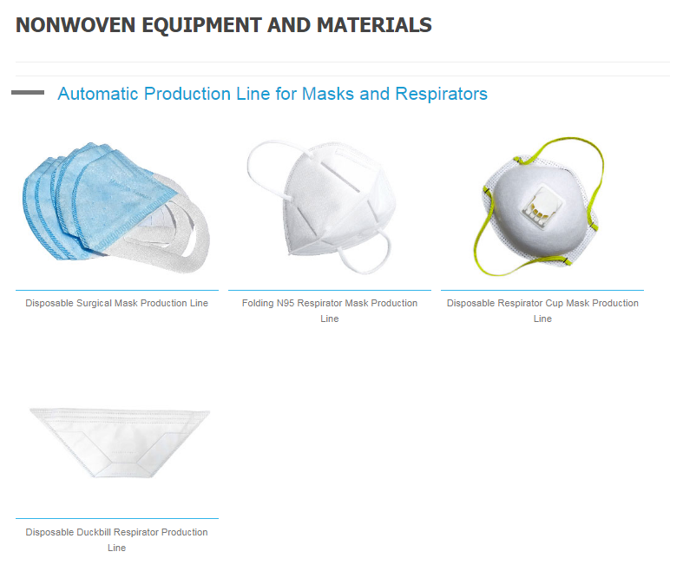
New products, protecting from the virus
Our Offers from large-sized equipment to final products

Slide 4
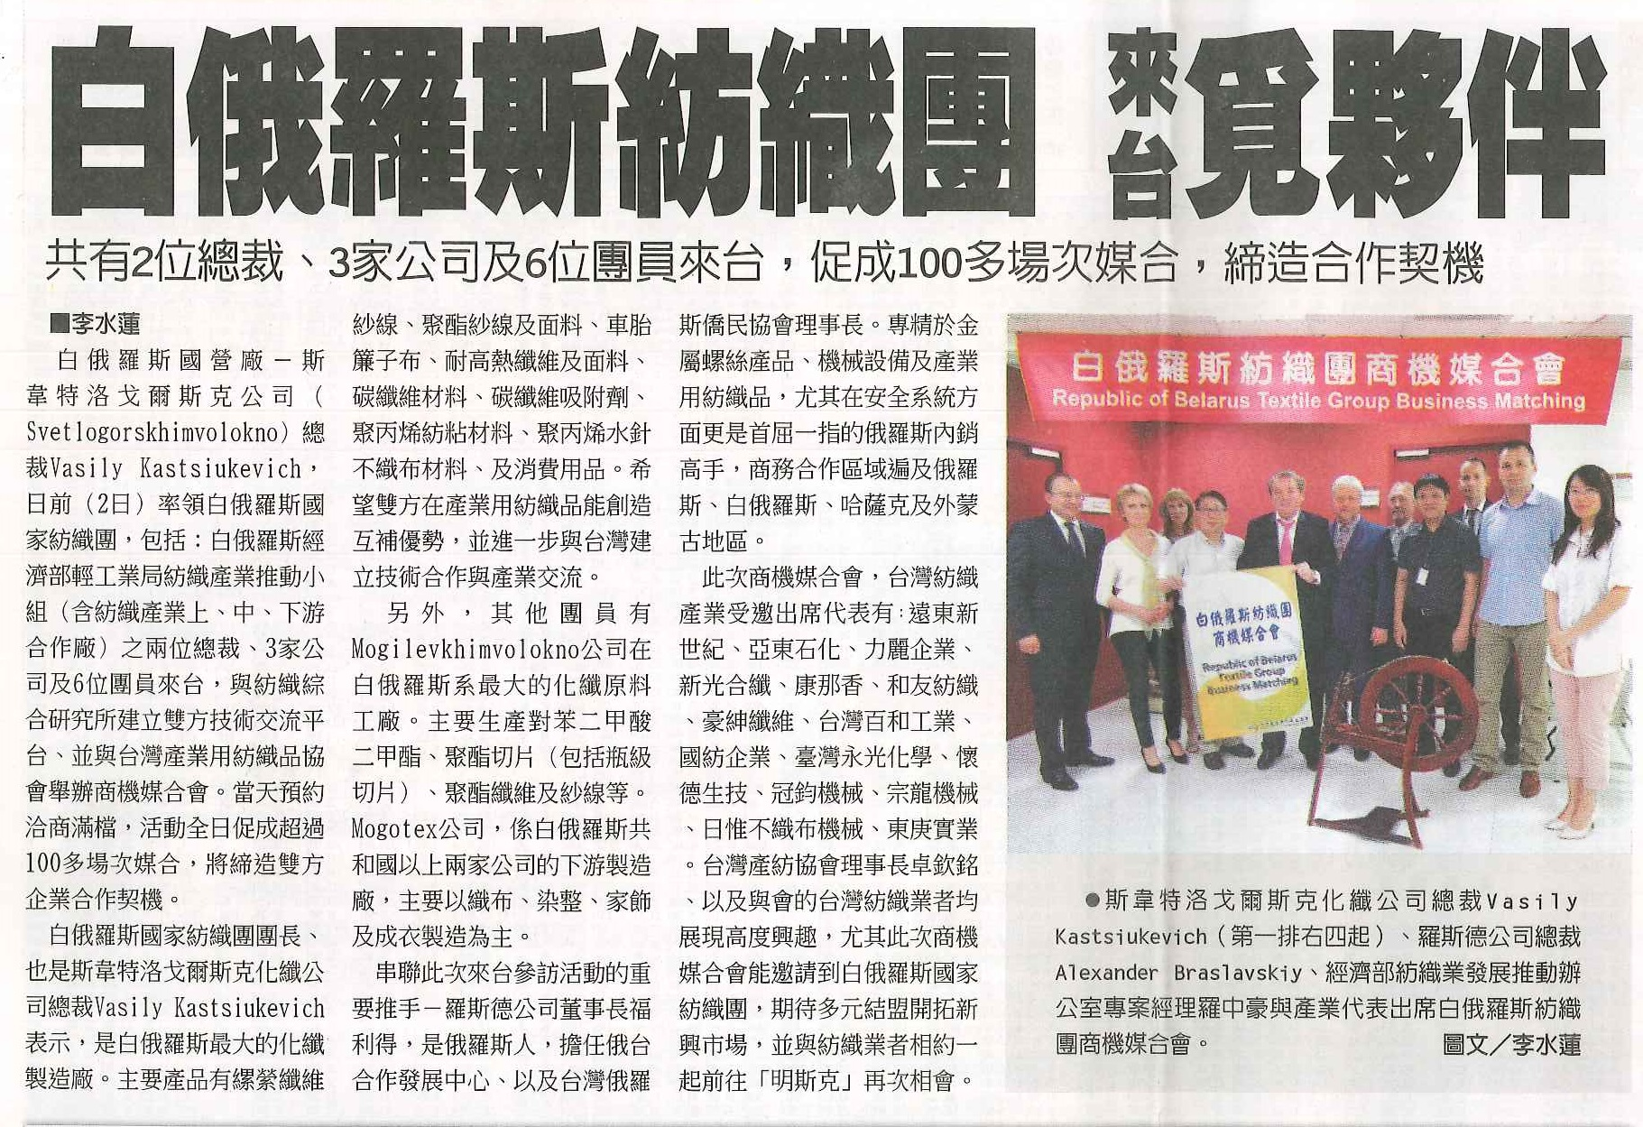
Completed cases in Belarus & in Russia
Spunlace laminator
Shuttle loom
Meltblown production line
Three beams SPUNBOND production line

Slide 5
Our best business partners
Our target is to develop reliable partnership with our clients and pursue the long-term business collaboration.

Slide 6
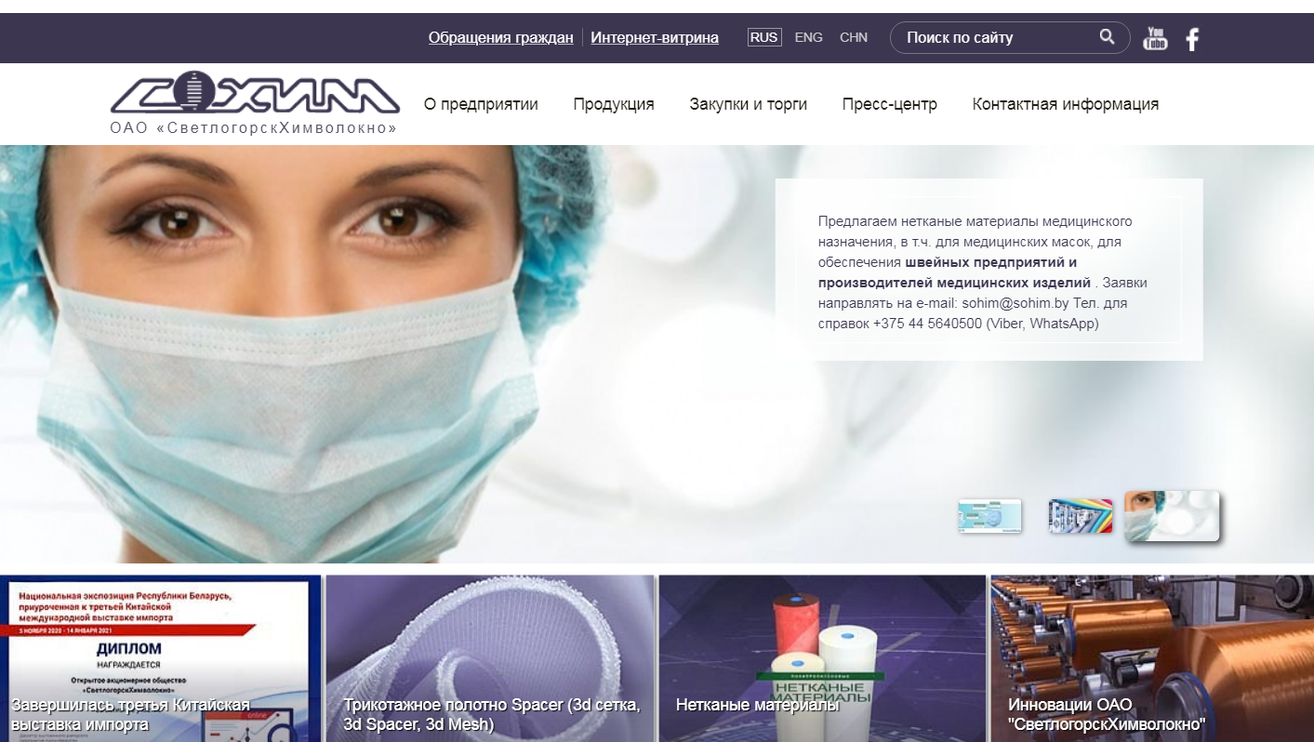

Slide 8
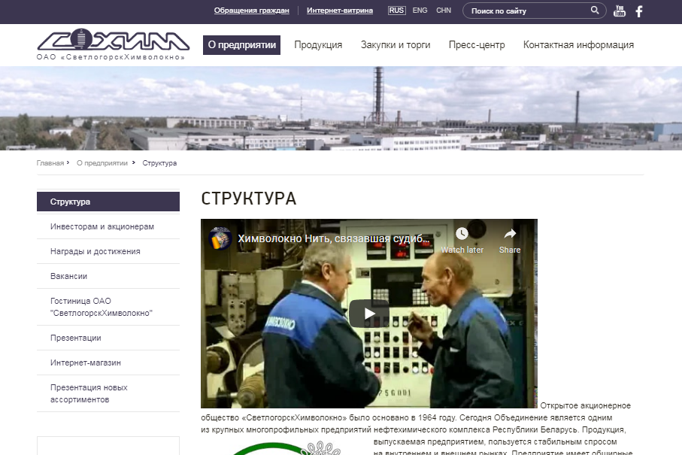

Slide 11
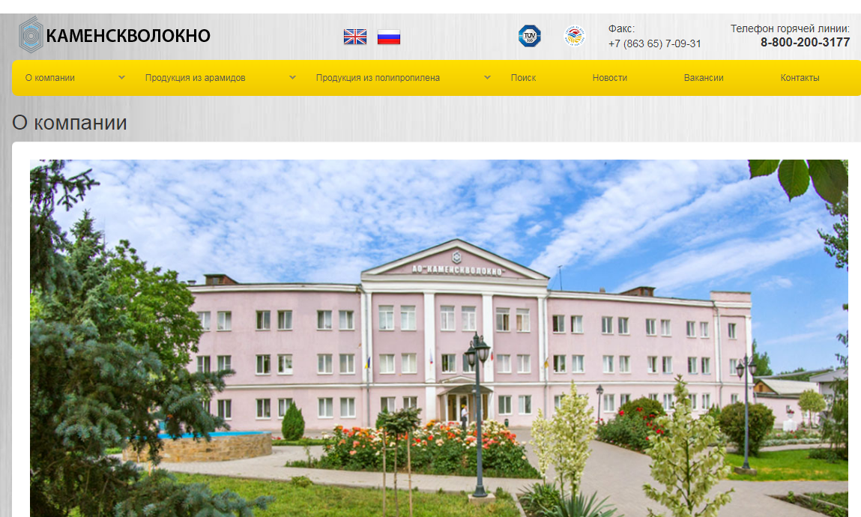

Slide 15
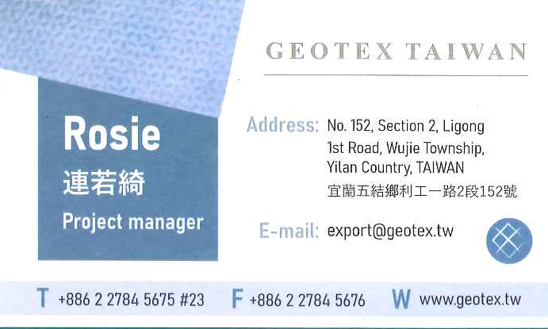
Contact person of Geotex Taiwan
專案經理 Project Manager 連若綺 Rosie Lien TEL:+886 2 2784 5675 ext.23 Email: export@geotex.tw
─ Thank you for your listening! ─

